Slide 1

Week 3: “Acing the Case” | Finch | Yazdjerd | Rizvi

Slide 2
If you could teach a class on one thing, what would it be?
Icebreaker!

Slide 3
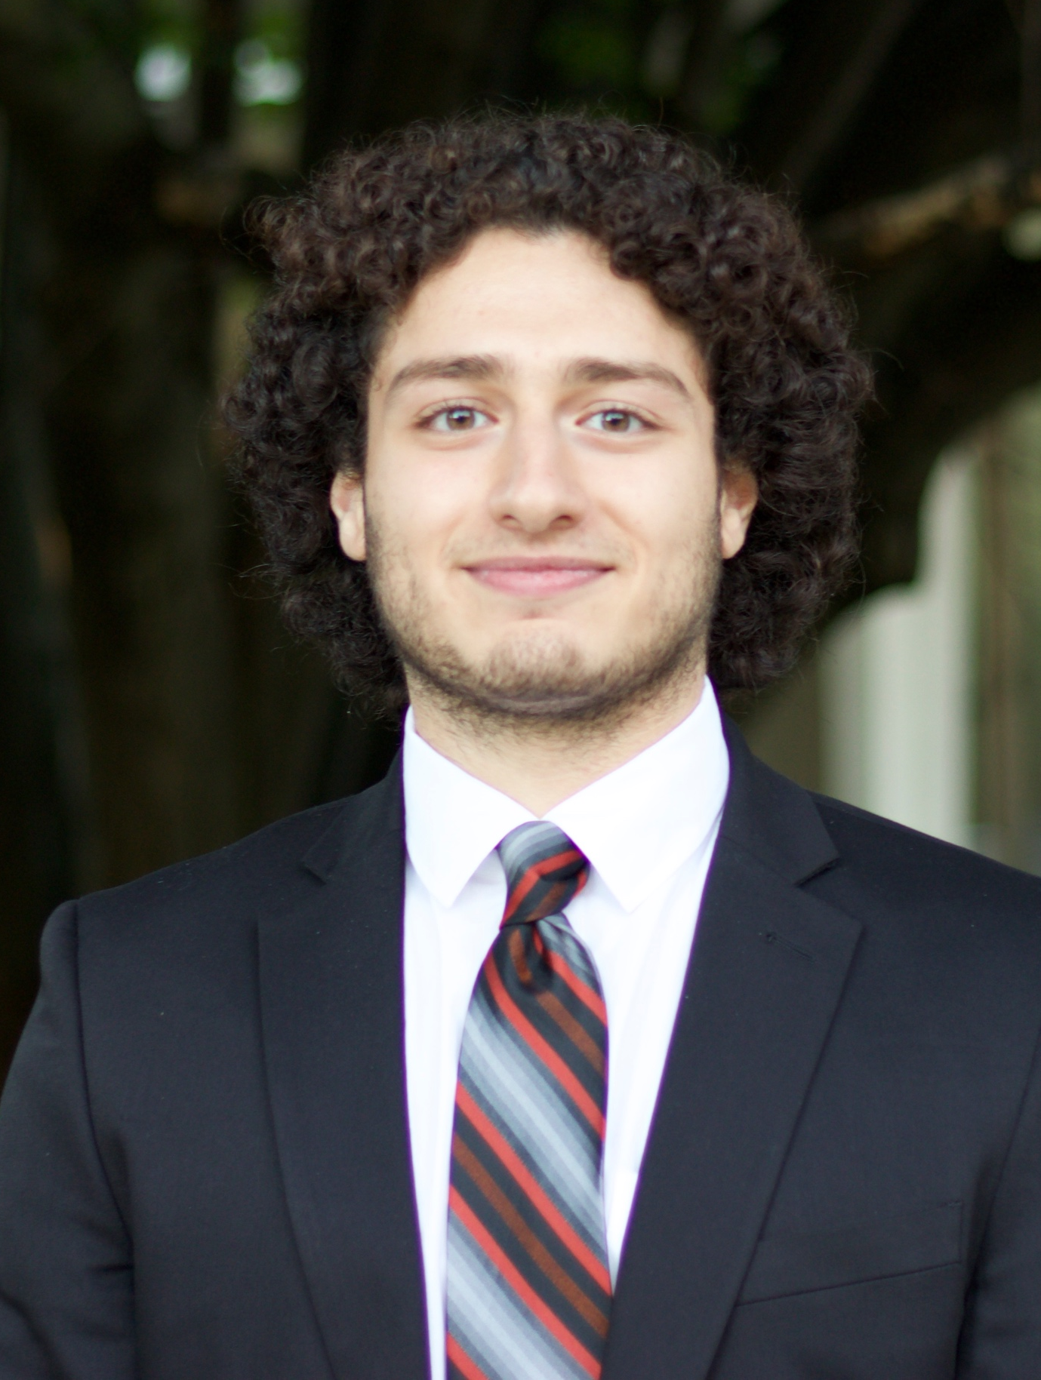
Tenured Member – Keanu Yazdjerd
Year: Junior
Hometown: Downingtown, PA
Majors: Finance
Minors: Information Systems Management (ISM)
Professional Experience: Incoming Strategy Summer Scholar at Deloitte
Previous NLCG Experience/Engagements: Associate Consultant – Boeing Project, Portfolio Development Lead – CTP, Engagement Manager – PSU D&I Project, Vice President of Corporate Relations
Other PSU Involvements: Phi Gamma Nu, Business Statistics TA
Hobbies/Interests: Philly Sports, UFC, Snowboarding

Slide 4

Tenured Member – Monem Rizvi
Year: Junior
Hometown: Bethlehem, PA
Majors: Finance
Minors: Information Systems Management (ISM)
Professional Experience: Incoming Finance Transformation Intern at KPMG
Previous NLCG Experience/ Engagements: Associate Consultant – Smeal Alumni Society Board, Engagement Manager – Wegmans, Director – SBU Black
Other PSU Involvements: Alpha Kappa Psi, Humanitarian Engineering & Social Entrepreneurship Program, Sapphire, FIN301 TA, and Smeal Student Council
Hobbies/Interests: Colts Football, House of Dragon, Professional Mini-Golf

Slide 5
Tonight’s Agenda

Slide 6






Agenda
Intro To Casing
Beginning a Case
Body of a Case
Conclusion
In Person Case
Looking Ahead

Slide 7


Consulting Interviews
Behavioral Interview
Case Interview
Introduction

Slide 8
Consulting Interviews
Behavioral Interview
Case Interview
Introduction

Slide 9




Case Interviews
how
you
think
Quantitative Mindset
Navigate Ambiguity
Conceptualize Information
Analytical Approach
Introduction

Slide 10
Case Interviews
The interviewer is looking to see
how you think
Introduction

Slide 11

Types of Cases
1
Market
Entry
Introduction

Slide 12

Types of Cases
2
Profitability
Introduction

Slide 13

Types of Cases
3
Merger & Acquisition
Introduction

Slide 14
Format of a Case
Prompt
Body
Close
Introduction

Slide 15
Format of a Case
Case Spectrum
Interviewer reads prompt
Take abundance of detailed notes
Repeat back key details to make sure you have all the necessary info
Prompt
(5 min)
One broad question
A few specific questions
Not many facts given; forced to dig for details
No additional details than what is given
Interviewer-Led:
Question and answer driven case
Interviewee-Led:
You set the framework and drive the case
Body
(20+ min)
Conversational; back and forth
“What do you think” to any questions you ask
Close
(5 min)
Summarize case findings
Give recommended next steps
Questions for the interviewer
Interviewee-Led
Interviewer-Led
Introduction

Slide 16
Beginning a Case: Prompt
Before prompt
During prompt
Utilize multiple pieces of paper
Organize your notes
Identify key pieces of info
Take notes
Write neatly
Stay organized
Notes
Objective(s)
After prompt
Framework
Restate facts of prompt
Ask for additional goals or objectives
What constitutes success?
Clarifying questions
Beginning

Slide 17


Beginning a Case: Framework
After clarifying questions, ask the interviewer for a moment to gather your thoughts before moving on to the framework
Why use frameworks?
Demonstrates strong critical thinking skills to the interviewer
Provides a roadmap for further analysis throughout the case
Intuitive
Specific
Identify factors that break down the larger problem
Keep it M.E.C.E
Factors should be tailored to the firm and problem at hand
Avoid “cookie-cutter” frameworks
Beginning

Slide 18
Beginning a Case: Questions
Prompt
Our client is a global consumer packaged goods company, called Kilaru Clean, that makes paper products such as paper towels, cleaning products, and laundry care products. The company’s CEO has set a sales target of $2B in 4 years while sales are currently at $1B. Our client would like you to develop a strategy to deliver this growth. What factors would you consider in helping Kilaru Clean attain their goal?
Things to consider
What regions does this company operate in?
How does this company make money?
How long has this problem been occurring?
Is this a firm-specific or industry-wide problem?
What are their main distribution channels?
Beginning

Slide 19



Beginning a Case: Framework
Sample Framework
Kilaru Internal Capabilities
CPG Market Outlook
Risk Factors
Beginning

Slide 20
Beginning a Case: Framework
Sample Framework
Kilaru Internal Capabilities
CPG Market Outlook
Risk Factors
Understand Kilaru Clean’s background
Segment into current product lines and new product investments
Determine most profitable segments to best allocate resources
Beginning

Slide 21
Beginning a Case: Framework
Sample Framework
Kilaru Internal Capabilities
CPG Market Outlook
Risk Factors
Beginning

Slide 22
Beginning a Case: Framework
Sample Framework
Kilaru Internal Capabilities
CPG Market Outlook
Risk Factors
How is the market growing?
What is our current market share?
Customer/ competitor analysis
M&A opportunities
Beginning

Slide 23
Beginning a Case: Framework
Sample Framework
Kilaru Internal Capabilities
CPG Market Outlook
Risk Factors
Beginning

Slide 24
Beginning a Case: Framework
Sample Framework
Kilaru Internal Capabilities
CPG Market Outlook
Risk Factors
Technological Risks
Cultural impact
Intangibles
Beginning

Slide 25
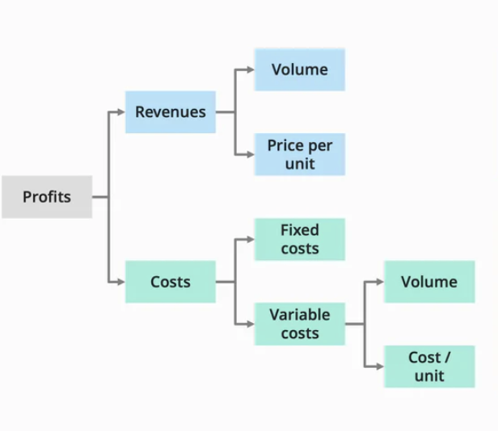
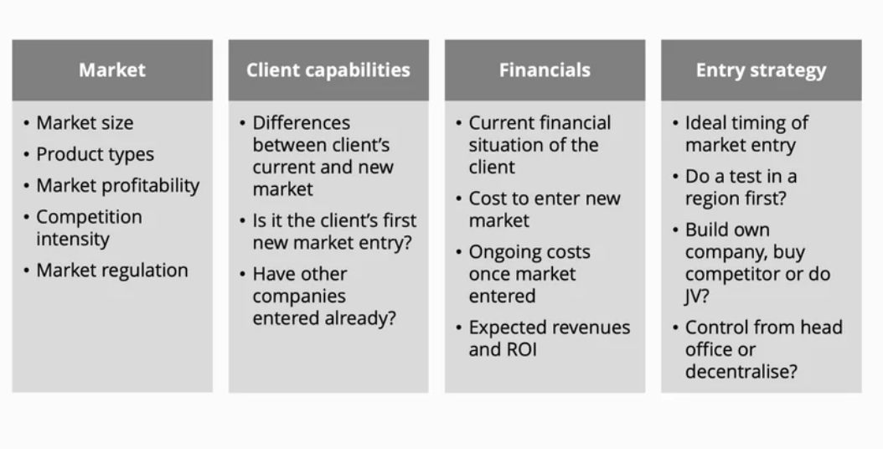
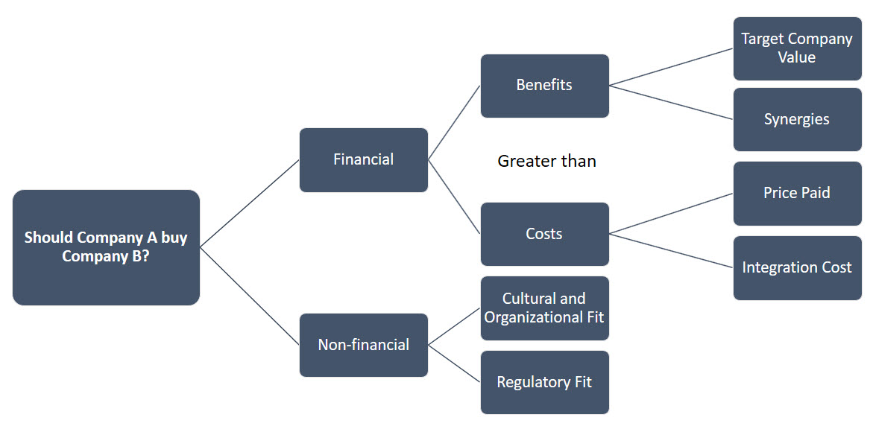
Beginning a Case: Framework
Examples for all three case types
Profitability
Market Entry
Merger and Acquisition
Beginning

Slide 26
Beginning a Case: Recap
Take notes throughout reading of prompt, provide recap
Follow up with questions (3 or more)
Take a second to develop framework, then provide interviewer with explanation
Beginning

Slide 27
Body

Slide 28
Body of a Case: Market Size and Case Math
How to succeed:
Market Size:
Explain your reasoning and decisions you make
Be quick with math but also accurate
If you need time to think, tell your interviewer, do not go silent
Case Math:
Explain how you did your calculations
Explain the importance!
Once you get to the end of your math, always relate back to prompt
Body

Slide 29
Body of a Case: Brainstorming
Top-down approach
Things to consider
Summarize
high-level ideas
Dive into reasoning behind them
Prioritize by importance
Take time to think
Write down your answers
Bucket key ideas
Top-down approach
Body

Slide 30
Body of a Case: Brainstorming
Will be prompted to brainstorm
Sample Case Practice
Identify ways in which our client, Kilaru Clean, can increase sales through internal changes within the next four years.
Location
Optimize
Pricing
R&D
Marketing
Expand into new product lines
Tissues, Cleaning supplies, etc.
Prioritize highly profitable regions
Expand into developing markets
Evaluate current marketing plan
Aggressive advertising to increase brand awareness
Analyze competitors' prices
Increase profitability
Body

Slide 31
Body of a Case: Analytics
Quantitative Questions
Charts and Graphs
Looking for your ability to
Considerations
Work with large numbers
Structure analysis
Pay attention to detail
What information are you looking at?
What patterns do you see?
Considerations
Why are these patterns changing?
How does this info tie into the case?
Talk through math problems
Give the “so what” behind each calculation
Take time to get the math right
Body

Slide 32
Conclusion

Slide 33
Ending a Case: Conclusion
Things to consider
Clearly state your recommendation
“I recommend that”
Be concise and don’t go into every detail of the case
If applicable, include risks and next steps
Ending

Slide 34
Practice Case

Slide 35
Pizzanomics
Adapted from the Ross Consulting Club 2010 Casebook
Category: Profitability
Difficulty: Easy
(NLCG Casebook)

Slide 36
Introduction: Pizzanomics
Problem Statement
Info upon Request
An aspiring chef, Emily Gernert, just moved to NY, and is trying to decide if it makes more sense to get in on the new fad of high-end pizza places with imported cheese and wood burning ovens, or open a more traditional pizza place.
Which type of restaurant will be more profitable?
Startup costs are the same to buy ovens and other materials
Both types of restaurants need the same amount of space
The traditional place uses locally sourced materials while the high-end places imports mozzarella from Italy. The high-end place also offers a different set of topping options
Both markets are equally developed
Don’t let the candidate start asking for numbers yet—info on cost and revenue in future slides
Practice

Slide 37
Framework
What kind of structure would you create for this situation?
What cost drivers might you consider and how could they differ between the two types of restaurants?
Practice

Slide 38
Cost Structure
Labor – High end: 5,500 per week, Traditional: 3,500 per week; (52/yr)
Utilities – High end: $550 per month Traditional: $800 per month
Wood - $400 per cord of wood, 3 cords needed per month
Rent – High end: $6000 per month, Traditional: $5000 per month
Pizza – (materials cost per pizza) High end: $4, Traditional: $3
You estimate # of units per restaurant
Toppings – Volume drives price differential
How much do you think each type of restaurant would spend on toppings?
Practice

Slide 39
Cost Structure
High End Pizza Place
Traditional Pizza Place
 | Unit Cost | Units | Total
Labor | $5,500 | 52
Utilities | $550 | 12
Wood | $400 | 36
Rent | $6,000 | 12
Pizza | $4 | 72,000
Toppings | $100,000 | 1
Misc.
Total
 | Unit Cost | Units | Total
Labor | $3,500 | 52
Utilities | $800 | 12
Wood |  | N/A
Rent | $5,000 | 12
Pizza | $3 | 23,000
Toppings | $25,000 | 1
Misc.
Total
Practice

Slide 40
Cost Structure
High End Pizza Place
Traditional Pizza Place
 | Unit Cost | Units | Total
Labor | $5,500 | 52 | $286,000
Utilities | $550 | 12 | $6,600
Wood | $400 | 36 | $14,400
Rent | $6,000 | 12 | $72,000
Pizza | $4 | 72,000 | $288,000
Toppings | $100,000 | 1 | $100,000
Misc. |  |  | $25,000
Total |  |  | $792,000
 | Unit Cost | Units | Total
Labor | $3,500 | 52 | $182,000
Utilities | $800 | 12 | $9,600
Wood |  | N/A | $0
Rent | $5,000 | 12 | $60,000
Pizza | $3 | 23,000 | $69,000
Toppings | $25,000 | 1 | $25,000
Misc. |  |  | $30,000
Total |  |  | $375,600
Practice

Slide 41
Revenue Structure
What revenue drivers might you consider and how could they differ between the two types of restaurants?
Practice

Slide 42
Revenue Structure
Plain Pizza – High end: $10 per pizza for 22,000 pizzas, Traditional: $13 per pizza for 11,000 pizzas
Specialty Pizza – High end: $12 per pizza for 50,000 pizzas Traditional: $17.50 per pizza for 12,000 pizzas
Additional: (drinks, etc.) – High end: $70,000, Traditional: $90,000
Calculate both revenue and profit
Practice

Slide 43
Revenue Structure
High End Pizza Place
Traditional Pizza Place
 | Unit Price | Units Sold | Total
Plain Pizza | $10 | 22,000
Specialty | $12 | 50,000
Total |  | 72,000
Additional | (drinks, | etc.) | $70,000
Total Rev.
Total Cost |  |  | $792,000
Profit
 | Unit Price | Units Sold | Total
Plain Pizza | $13 | 11,000
Specialty | $17.50 | 12,000
Total |  | 72,000
Additional | (drinks, | etc.) | $90,000
Total Rev.
Total Cost |  |  | $375,600
Profit
Practice

Slide 44
Revenue Structure
High End Pizza Place
Traditional Pizza Place
 | Unit Price | Units Sold | Total
Plain Pizza | $10 | 22,000 | $220,000
Specialty | $12 | 50,000 | $600,000
Total |  | 72,000 | $820,000
Additional | (drinks, | etc.) | $70,000
Total Rev. |  |  | $890,000
Total Cost |  |  | $792,000
Profit |  |  | $98,000
 | Unit Price | Units Sold | Total
Plain Pizza | $13 | 11,000 | $143,000
Specialty | $17.50 | 12,000 | $210,000
Total |  | 72,000 | $353,000
Additional | (drinks, | etc.) | $90,000
Total Rev. |  |  | $443,000
Total Cost |  |  | $375,600
Profit |  |  | $67,400
The high-end pizza place sells many more pizzas, especially specialty. Strong candidates will notice that the high-end place doesn’t make any additional profit on specialty, since there is no extra margin put in, only enough to cover the cost of toppings.
Practice

Slide 45
Market Size
What is the market size for all pizza sold in New York City in 2020 in dollars?
A strong approach should:
Consider different types of pizza places, like the ones discussed in this case
Utilize the population of New York City, which can be estimated as 8 million
Be clearly communicated and well organized
Population 8,000,000
How many eat pizza? 80%
Avg Slice/week 1
Cost/slice $2
Weeks/year ~50
Total Market Size= 8,000,000*0.80*1*$2*50=$640,000,000
Practice

Slide 46
Brainstorm
What are some ways that Emily can create more profit at his pizza place?
High End?
Traditional Pizza Place?
Charge more, especially for specialty pizza
Enter delivery business (may damage brand)
Sell other items (drinks merchandise etc.)
Decrease price on plain/specialty
Start Marketing program
Practice

Slide 47
Conclusion
Emily Gernert is coming to meet with us today. Would you walk her through what we covered today as well as your recommendation?
A strong conclusion should:
Summarize the key takeaways from each portion of the interview
Provide a conclusive recommendation on which type of pizza place Emily should open
Likely should choose High End as it is more profitable unless very strong risks are identified with a high-end place that outweigh the additional profits
Address risks associated with the recommendation
Include Next Steps
Practice

Slide 48
Market Sizing

Slide 49

Market Size Exercise
What is the market size of traditional toothbrushes in the United States in one year?
Market Size

Slide 50
Market Size Exercise
Step 1: Assume 330 million people in the United States
= 330 Million
Step 2: Assume 90% of people DO brush their teeth (babies, people that have teeth and choose not to brush them make up other 10%).
(0.9 * 330 million)
= 297 Million
Step 3: About 75% of the 297 million use regular toothbrushes.
(0.75 * 297 million)
~ 223 million
Step 4: Individuals use a new toothbrush about once a month, we'll say 10 for easier math.
(10*220million)
~ 2.23 billion
Step 5: Average toothbrush price is about $2.
($2 * 2.23 billion)
~ $4.5 billion
Market Size

Slide 51
Monem Rizvi (bald one) –
Mar6718@psu.edu
Keanu Yazdjerd –
Kmy5230@psu.edu

Slide 52




Submit Dues ($20)
Important Reminders this Week
This week:
Individual Case released (due 3/14)
NLCG Buddy pairings released tomorrow (introductory email by EOW)
Next week:
Week 4: “Leadership” (2/21 in 102 Animal Science)
Complete the individual case assignment
Participate in the team case assignment
Complete at least 4 mock interviews

